Slide 1
Batch 13
Project Presentation
Project Team:
Maneesh Reddy-18BTRCI019
K.Chandrika-18BTRCI024
T.Krishna Mohan Reddy-18BTRCI047

Slide 2
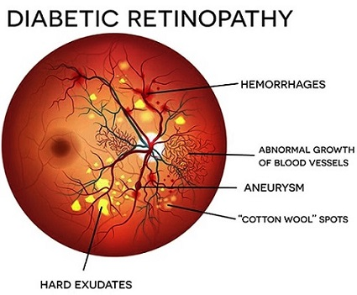
DIABETIC RETINOPATHY DETECTION
A model to detect Diabetic Retinopathy.

Slide 3
ABSTRACT
Detection of Diabetic Retinopathy: Diabetic retinopathy is a diabetes complication that affects eyes.
It's caused by damage to the blood vessels of the light-sensitive tissue at the back of the eye (retina).
At first, diabetic retinopathy might cause no symptoms or only mild vision problems.Risk Factors: Diabetes; Tobacco smoking Diseases or conditions caused: Blindness.

Slide 4
TECHNOLOGIES USED
Libraries and NN for ML model
TensorFlow
Keras
CNN
HTML
BOOTSTRAP

Slide 5
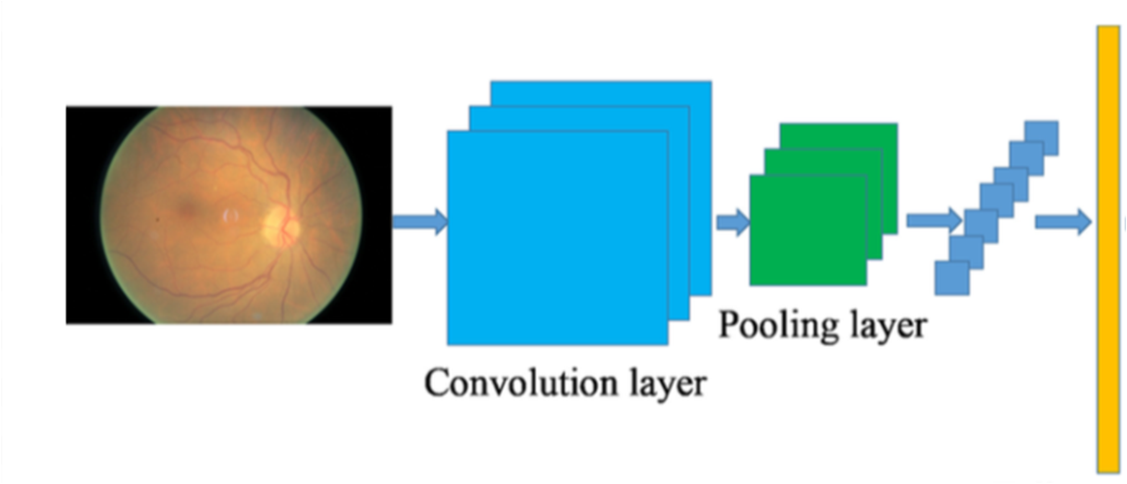
MODEL ARCHITECTURE
Fully connected layer

Slide 6
WORK ACCOMPLISHED

Slide 7
Proposed system
-The proposed system is a website has the option to upload the images
-The machine learning model will determine wether the uploaded image is diabetic retinopathic image or not
-The model in the proposed system is made using 5 layered CNN
-The website is built using HTML and CSS

Slide 8
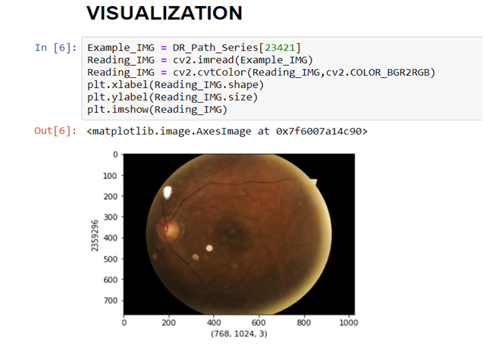
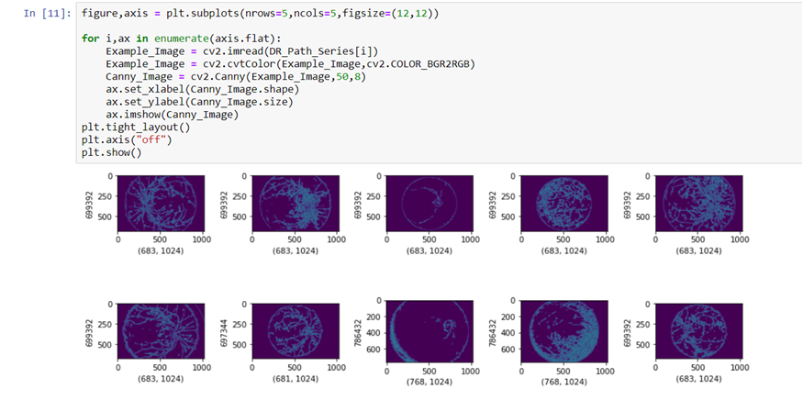
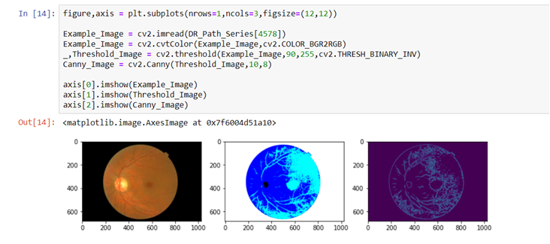
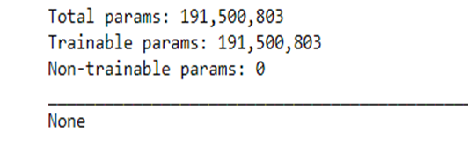

Slide 9
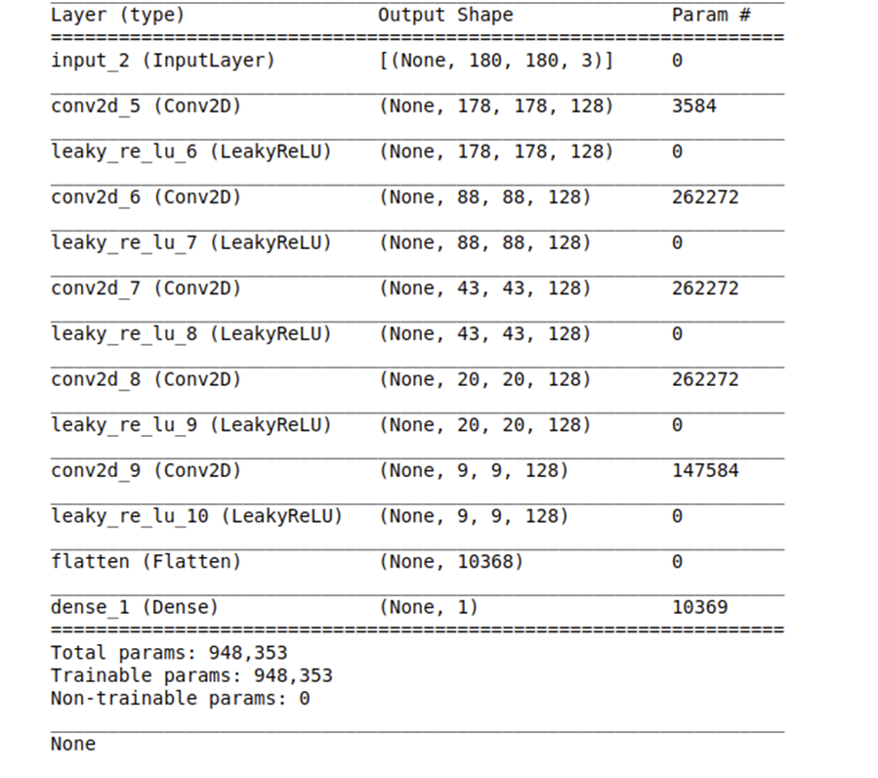
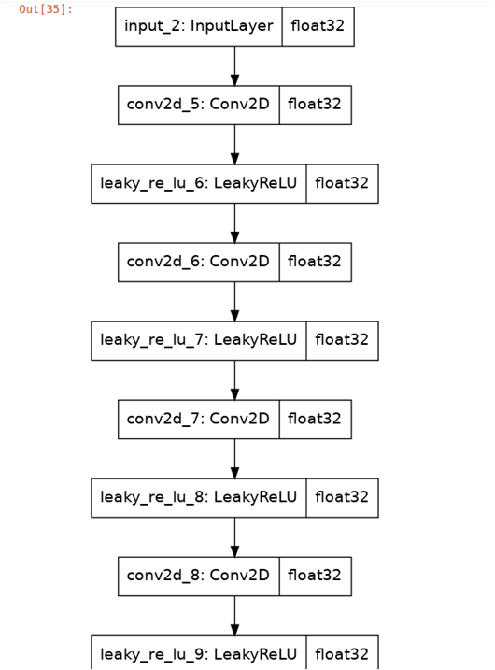

Slide 10
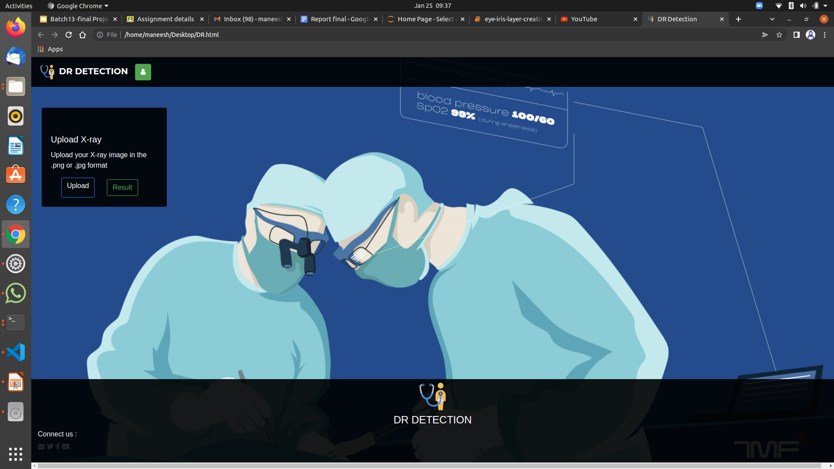

Slide 11
MOTIVE AND OBJECTIVE
The motive of this project is to detect diabetic retinopathy in early stages
CNN approach for diagnosing this from digital fundus image dataset from Kaggle and classifying its severity.
The objective of this project is to enable doctors to view variations in the fundus images with the help of image preprocessing techniques

Slide 12
USES
Time saving process.
Improved efficiency by reducing human errors.
Cost effective and easily manageable.

Slide 13
REFERENCE PAPERS

Slide 14
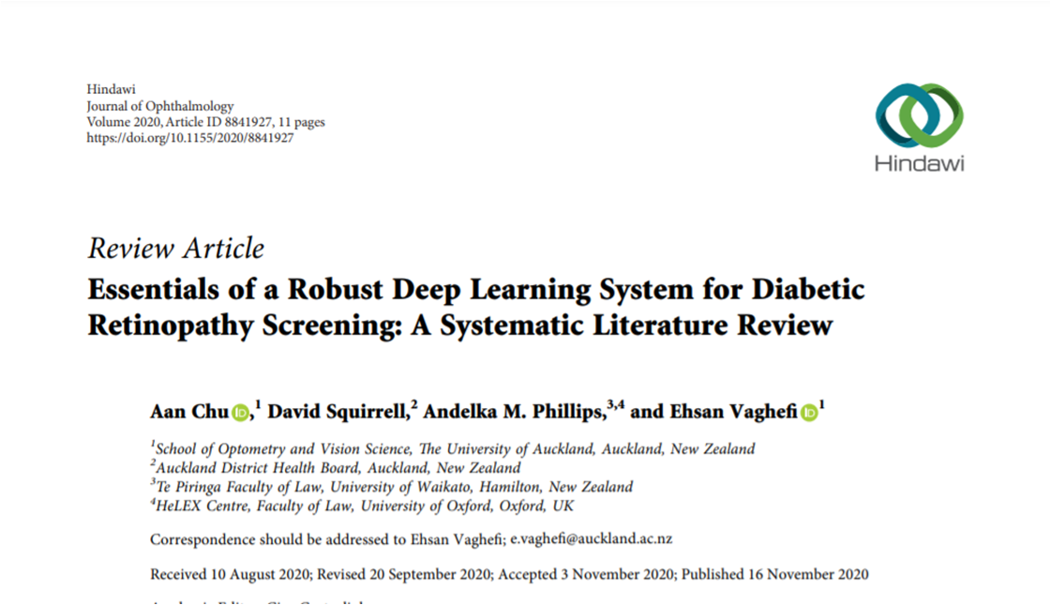

Slide 15
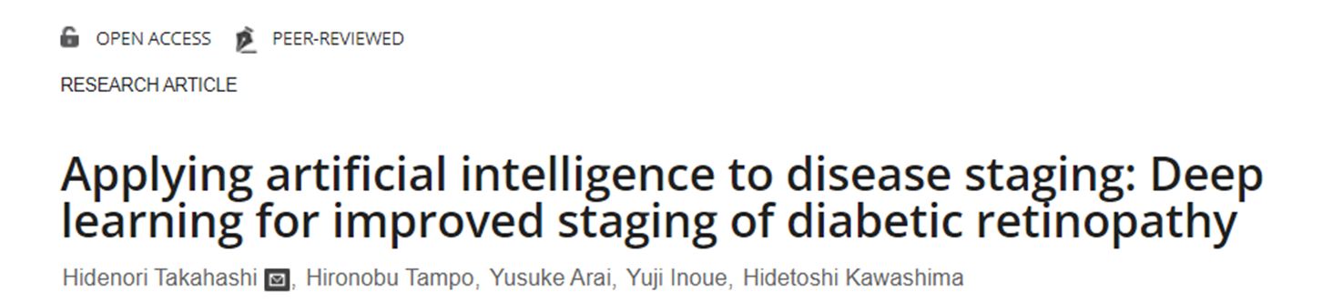
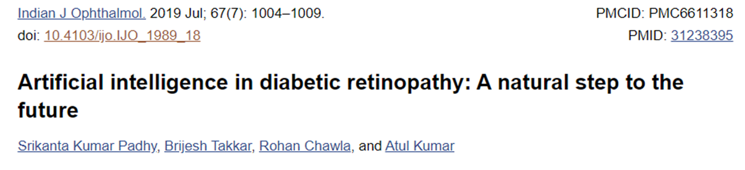

Slide 16
THANK YOU!

